Slide 1
Innovative Projects- Arduino Using Embedded ‘C’ (CSE1002) Phase –II Review Presentation TITLE OF THE PROJECT
Submitted to the Presidency University, Bengaluru in partial fulfillment of the requirements for the Innovative Project- Arduino Using Embedded ‘C’
Under the supervision of
Mrs. Aruna M Asst. Professor Department of Electronics Engineering April 23 , 2022

Slide 2
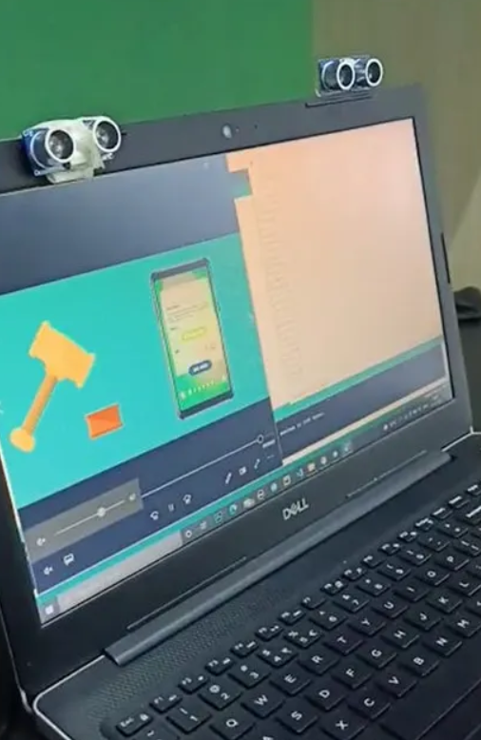
Preview
The Arduino Hand Gesture Project aims to harness advanced technology to develop a solution that significantly benefits humanity. This project is designed with a singular purpose: to provide an intuitive and contactless way of interacting with hardware systems.
By utilizing simple hand gestures, users can seamlessly control the desired devices, eliminating the need for direct physical contact. This innovation not only enhances convenience but also caters to applications where touchless interaction is crucial for safety and hygiene.

Slide 3
CONCEPT BEHIND
The concept is straightforward:
Two ultrasonic sensors are mounted on top of the monitor to detect the distance between the monitor and the user's hand using an Arduino. Based on the measured distance, specific actions are triggered.
The Arduino transmits these commands to the computer via a serial connection (USB). A Python script running on the computer reads the incoming data and executes the corresponding actions accordingly. This setup enables efficient and intuitive control of the system using simple hand gestures.

Slide 4
Uses
Human-Machine Interface (HMI) devices typically include LED indicators, switches, touch screens, and LCD displays. However, an alternative and intuitive method of interacting with machines, such as robots or computers, is through hand gestures.
Instead of relying on traditional input devices like keyboards, mice, or joysticks, hand gestures can be used to control various functions on a computer, such as playing or pausing a video, navigating through a photo slideshow, or scrolling through a webpage.
Given that not everyone has access to advanced, high-cost technology, this project aims to create a cost-effective motion-gesture control system for laptops or computers by leveraging the capabilities of Arduino and Python. This approach provides a more accessible and user-friendly way to interact with devices, bringing sophisticated functionality within reach for a broader audience.

Slide 5
Gesture Control Features
Tab Switching in Web Browser: Navigate between open tabs seamlessly using hand gestures.
Web Page Scrolling: Scroll up or down a webpage without touching the mouse or keyboard.
Task Switching: Effortlessly switch between open applications or tasks on your computer.
Slide Navigation in Presentations: Move through PowerPoint slides with simple gestures.
Play/Pause Video: Control media playback, such as playing or pausing a video, using hand movements.
Volume Adjustment: Increase or decrease the volume with intuitive gestures.
Video Forward and Rewind: Skip forward or rewind videos with a wave of your hand.

Slide 6
Procedure
Gather Necessary Hardware: Begin by collecting all the required components for the project.
Assemble the Circuit: Create a precise and functional circuit using the collected hardware components.
Connect to the Device: Attach the assembled circuit to your preferred device, such as a laptop or computer.
Install Arduino IDE: Download and install the Arduino IDE on your device.
Program the Arduino: Write and upload the necessary code to the Arduino using the IDE.
Install Required Software: Install the preferred programming language, such as Python, on your device.
Develop Python Code: Write the Python script to handle data and execute the desired actions.
Final Testing: Conduct a comprehensive test of the entire system to ensure it functions as expected. Once validated, the project is complete!

Slide 7
Components Used
ARDUINO UNO
ULTRASONIC SENSOR (HC- SR04)
USB (TYPE A, TYPE B ) CABLE
CONNECTING WIRES
TRIG(SENSOR 1) to D1(ARDUINO)
ECHO(SENSOR 1) to D2(ARDUINO)

Slide 8
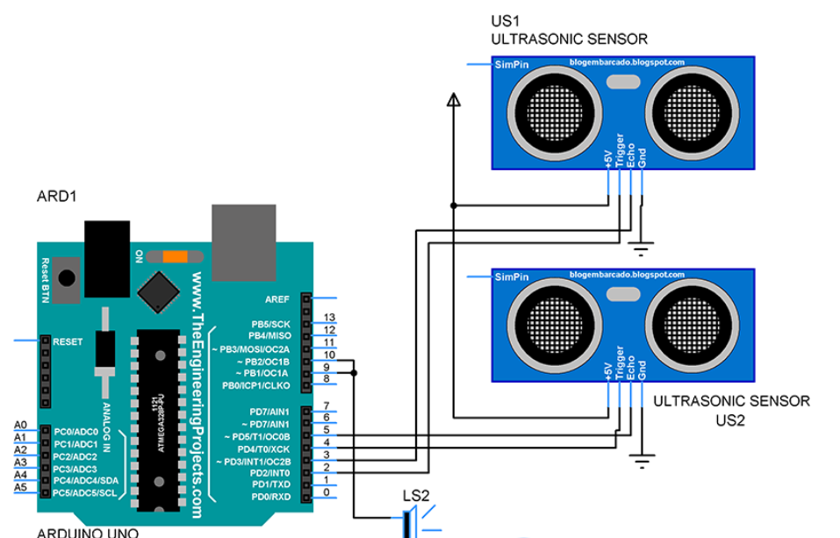
Circuit/Block Diagram

Slide 9
Arduino Using Hand Gestures
Step 1: Connect a Wire from Trig (Sensor -01) to Arduino uno to pin 1 in Arduino. Step 2: Connect a wire from Echo (Sensor 1 ) to D2of (Arduino) pin 2 in Arduino.
Step 3: Connect Ground (Sensor 1) to Ground of (Arduino) pin.
Step 4: Connect Ground (Sensor) to Ground of (Arduino) pin.
Step 5: Connect the Trip (Arduino 2) to D3 (Arduino) .
Step 6: Connect Echo (Arduino 2) to D4 (Arduino) .
Step 7: Connect VCC (Sensor 1 and 2) to 5V (Arduino) .

Slide 10
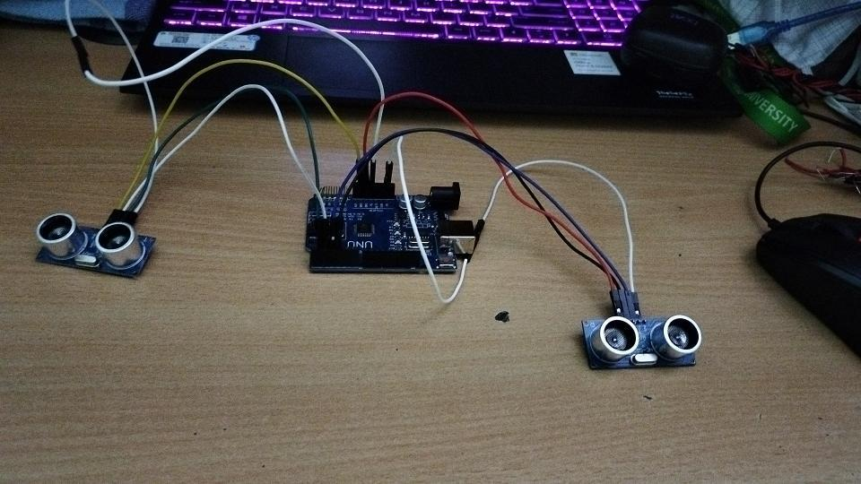
Connected Circuit

Slide 11
Conclusion
Through gesture recognition is still in its infancy state, the innovative market scenario which has seen Virtual Reality being a global phenomenon pushes us to admit that its supplication areas could keep on growing.

Slide 12
Project Timeline
Phase 2
Phase 3
Phase 1
Started Gathering data and spent some time in understanding the project.
We did some research, collected information and and mastered Arduino,
Project completion

